Slide 1
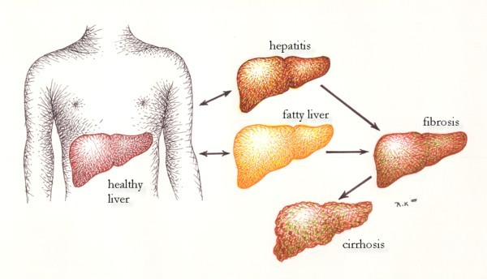
Acute Liver Failure Data Features
Jacinda Garcia
This Photo by Unknown Author is licensed under CC BY-SA-NC

Slide 2
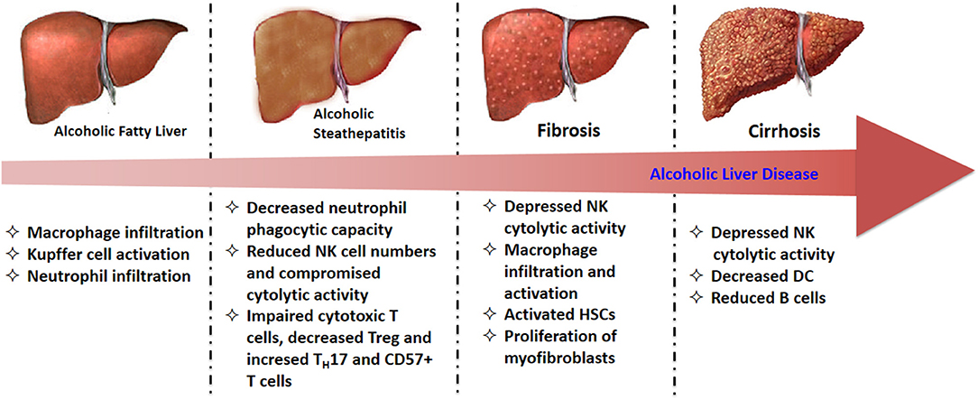
introduction
The aim of this model is to use this data set to find feature data most correlated with Acute Liver Failure(ALF). Modeling this will allow us not only to have a better understanding of risks related to ALF, but will also help predict a patients predisposition to ALF when key indicators are considered.
This Photo by Unknown Author is licensed under CC BY

Slide 3
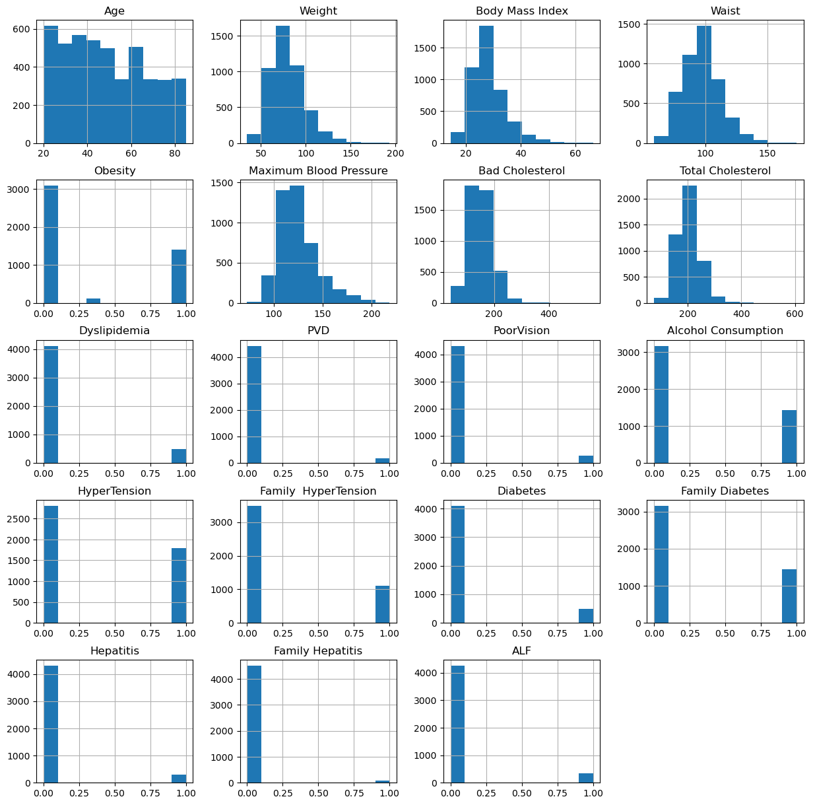
Dataset
Age
Gender
Region
Weight
Height
Body Mass Index
Obesity
Waist
Max BP
Min BP
Good Cholesterol
Bad Cholesterol
Total Cholesterol
Dyslipidemia
PVD
Physical Activity
Education
Unmarried
Income
Source of Care
Poor Vision
Alcohol Consumption
Hypertension
Family Hypertension
Diabetes
Family Diabetes
Hepatitis
Family Hepatitis
Chronic Fatigue
ALF
Notes:
The dataset analyzed started off with 30 features. In the data wrangling and data exploration process this number was reduced to just a few number of significant features. Data where ALF status was ‘NA’ was removed. Other features with missing data were filled by mean.

Slide 4
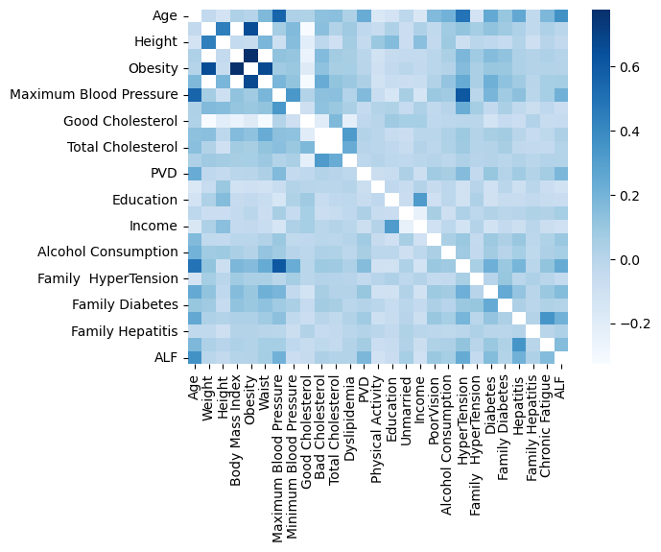
Heat map of features with less than .8 correlation

Slide 5
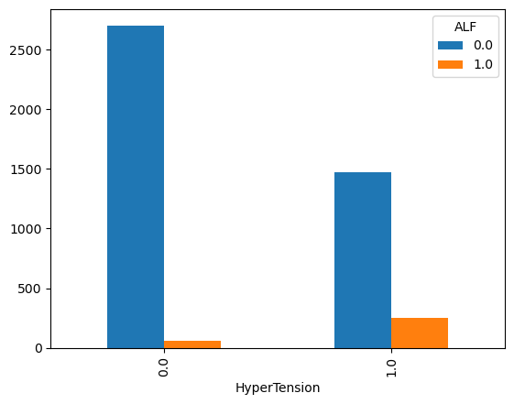
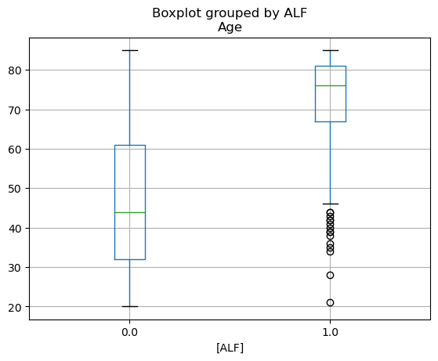
Data Exploration
Bar chart of categorical feature by alf status
Boxplot of continuous feature by alf status

Slide 6
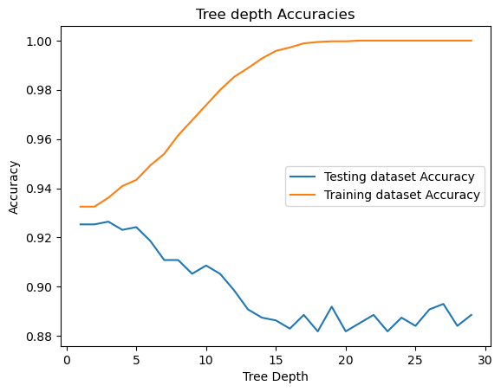
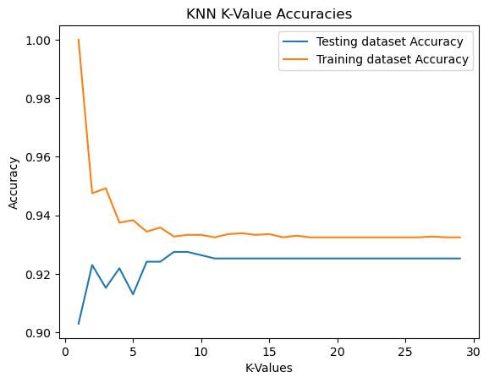
Tree depth & K value model

Slide 7
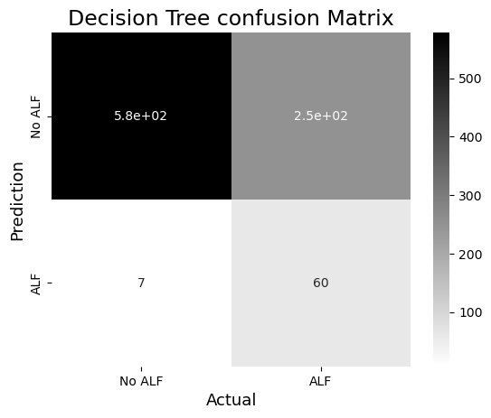
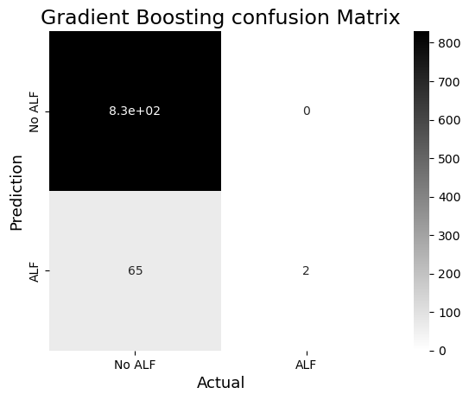
Decision Tree And Gradient Boost

Slide 8
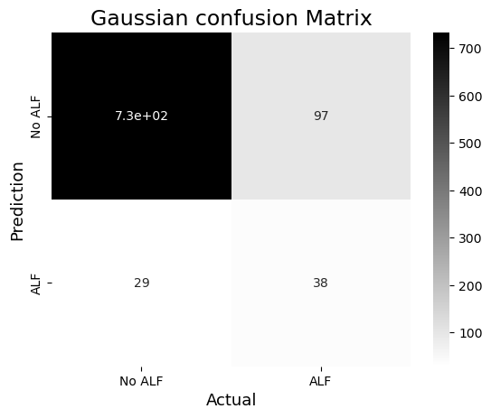
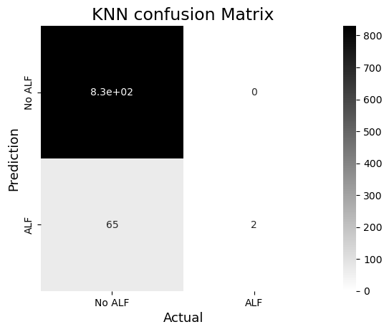
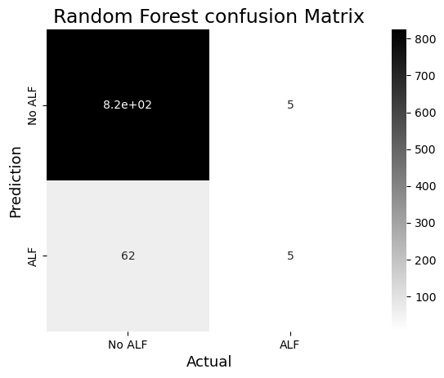
Gaussian, K Nearest neighbors, & Random Forest

Slide 9
Model Performance Comparison

Slide 10
Conclusion
Due to the nature of this dataset, no model was impressive in terms of predicting ALF through the Given features. KNN and Gradient Boosting had the highest precision for ALF, but this is likely due to the lack of ALF targets in those models. The Gaussian model had more ALF Targets, but only a precision of 0.28 for ALF. The Decision Tree and Random Forest models allowed for balancing of class weights and max depth specification. Even with the allowance of ALF targets in the range of the non-ALF quantity, these models failed to give a precise ALF score.
After reviewing these results, it is concluded that the dataset is not comprehensive enough to accurately predict risk factors of ALF. More positive ALF data is needed to improve model precision and performance. Future models and methods should focus on balancing within datasets and possibly adding features.

